Slide 1
Cookbook Attributes, Attribute Files and Dependencies
Setting attributes within a cookbook
Notes:
This section's goal is to have you bootstrap another node, this time a web server, and add it to the proxy members.

Slide 2
Objectives
After completing this module, you should be able to
Explain where cookbook attributes reside
Configure dependencies between cookbooks
Use knife ssh command
Notes:
In this module you will learn how to bootstrap, update the run list, and run chef-client on a node. You will also learn how to update a default attribute within a recipe, version and upload a cookbook.

Slide 3


Our topology
We now have a load balancer & two web servers, all listening on port 80
tcp/80
webserver
tcp/80
Workstation
Loadbalancer
tcp/80
webserver
Notes:
With a single web server running with our organization, it's now time to talk about the next goal to tackle. We need to setup a proxy server.
A proxy server is able to receive requests and relay them to other systems. In our case, we specifically want to use the proxy server to balance the entire traffic load between one or more systems.
This means we will need to establish a new node within our organization, install the necessary software to make the node a proxy server, and configure it so that it will relay requests to our existing node running apache and to future nodes.

Slide 4
Our topology
We now have a load balancer & two web servers, all listening on port 80
IT have mandated that direct access to the webservers should be blocked
tcp/8080
webserver
tcp/80
Workstation
Loadbalancer
block
tcp/8080
tcp/8080
webserver
Notes:
With a single web server running with our organization, it's now time to talk about the next goal to tackle. We need to setup a proxy server.
A proxy server is able to receive requests and relay them to other systems. In our case, we specifically want to use the proxy server to balance the entire traffic load between one or more systems.
This means we will need to establish a new node within our organization, install the necessary software to make the node a proxy server, and configure it so that it will relay requests to our existing node running apache and to future nodes.

Slide 5
GE: Reconfigure Apache
So we want HAProxy to serve content of port tcp/80, and Apache to serve of tcp/8080
Reconfigure Apache to serve content of port tcp/8080
Reconfigure HAProxy to contact Apache on port tcp/8080

Slide 6
Reconfigure Apache
Apache is configured to listen on port 80 in the file /etc/httpd/conf/httpd.conf
We will create a template for this file in the apache cookbook and change the value to 8080 via an attribute

Slide 7
Attribute Files
The Node Object contains many automatic attributes generate by OHAI
You can also maintain attributes within a cookbook
These are like variables or parameters for your cookbook and allow recipes to be data driven

Slide 8
Best Practices
Well-written cookbooks change behavior based on attributes
Ideally, you don't have to modify the contents of a cookbook to use it for your specific use case
Look at the attributes directory for things you can override through roles to affect behavior of the cookbook
Of course, well written cookbooks have sane defaults, and a README to describe all this.

Slide 9
Setting attributes in attribute files
Cookbook attributes are set in the attributes file
./cookbooks/<cookbook>/attributes/default.rb
Format is
We'll look at precedence later....

Slide 10
GE: Bump the cookbook version number
cookbooks/apache/metadata.rb
name 'apache'
maintainer 'The Authors'
maintainer_email 'you@example.com'
license 'all_rights'
description 'Installs/Configures apache'
long_description 'Installs/Configures apache'
version '0.3.0'

Slide 11
GE: Generate the attributes file
$ cd ~/chef-repo
$ chef generate attribute cookbooks/apache default
Compiling Cookbooks...
Recipe: code_generator::attribute
* directory[cookbooks/apache/attributes] action create
- create new directory cookbooks/apache/attributes
* template[cookbooks/apache/attributes/default.rb] action create
- create new file cookbooks/apache/attributes/default.rb
- update content in file cookbooks/apache/attributes/default.rb from none to e3b0c4
(diff output suppressed by config)
Notes:
Use 'chef generate template' to create a template in the apache cookbook found in the cookbooks/apache directory and the file we want to create is named index.html.

Slide 12
GE: Set the port value as an attribute
cookbooks/apache/attributes/default.rb
default['apache']['port'] = 8080
Its good practice to include the name of the cookbook in the attribute name – help trace where the value is set!

Slide 13
GE: Update the apache::server recipe
cookbooks/apache/recipes/server.rb
...
template '/var/www/html/index.html' do
source 'index.html.erb'
end
template '/etc/httpd/conf/httpd.conf' do
action :create
source 'httpd.conf.erb'
notifies :restart, 'service[httpd]'
end
service 'httpd' do
action [ :enable, :start ]
end`
Notes:
<<WIP We don't need the variable here – could just pass the attribute directly into the template. Maybe hard code it in the recipe?

Slide 14
GE: Generate the Template file
$ cd ~/chef-repo
$ chef generate template cookbooks/apache httpd.conf.erb
output suppressed by config)
MacBook-Pro-3:chef-repo johnfitzpatrick$ chef generate template cookbooks/apache httpd.conf.erb
Compiling Cookbooks...
Recipe: code_generator::template
* directory[cookbooks/apache/templates/default] action create (up to date)
* template[cookbooks/apache/templates/default/httpd.conf.erb] action create
- create new file cookbooks/apache/templates/default/httpd.conf.erb
- update content in file cookbooks/apache/templates/default/httpd.conf.erb from none to e3b0c4
(diff output suppressed by config)
Notes:
Use 'chef generate template' to create a template in the apache cookbook found in the cookbooks/apache directory and the file we want to create is named index.html.

Slide 15
GE: Add the 'port' variable to the Template
cookbooks/apache/templates/default/httpd.conf.erb
...
MaxSpareThreads 75
ThreadsPerChild 25
MaxRequestsPerChild 0
</IfModule>
Listen 80
Listen <%= node['apache']['port'] %>
LoadModule auth_basic_module modules/mod_auth_basic.so
LoadModule auth_digest_module modules/mod_auth_digest.so
...
If you are feeling hardcore, type it
http://bit.ly/1Hdx7E1
Copy entire contents of file, paste into the template, and edit line 27
Notes:
Gist here http://bit.ly/1Hdx7E1

Slide 16
Lab: Upload the Cookbook
Upload the apache cookbook to the Chef Server
Notes:
As a lab exercise, upload the cookbook to the Chef Server
Instructor Note: Allow 5 minutes to complete this exercise.

Slide 17
Lab: Upload the Cookbook
$ cd ~/chef-repo/cookbooks/apache
Notes:
Lets review that lab.
You change into the directory for the 'myhaproxy' cookbook.

Slide 18
Lab: Upload the Cookbook
$ berks install
Resolving cookbook dependencies...
Fetching 'apache' from source at .
Fetching cookbook index from https://supermarket.chef.io...
Using apache (0.3.0) from source at .
Notes:
We use the Berkshelf to upload our cookbooks. This is where Berkshelf really shines as a tool.
Run the command "berks install".
When you run this command for a cookbook that has a dependency, you'll see that Berkshelf will download the haproxy cookbook and its dependencies as well. The haproxy cookbook is dependent on the build-essential cookbook and the cpu cookbook. If any of those cookbooks had dependencies, berkshelf would find those and download them as well.
Instructor Note: Berkshelf downloads these cookbooks into a common directory within your home path. They are not added alongside your other cookbooks.

Slide 19
Lab: Upload the Cookbook
$ berks upload
Uploaded apache (0.3.0) to: 'https://api.opscode.com:443/organizations/ORGNAME'
Notes:
After installing all the necessary dependent cookbooks, we used 'berks upload' to send the cookbook and all its dependencies to the Chef Server. This is again an easier method to manage dependencies instead of manually identifying the dependencies and then uploading each single cookbook at a time.

Slide 20
GE: Reconfigure Apache
So we want HAProxy to serve content of port tcp/80, and Apache to serve of tcp/8080
Reconfigure Apache to serve content of port tcp/8080
Reconfigure HAProxy to contact Apache on port tcp/8080

Slide 21
GE: Bump the haproxy cookbook version
cookbooks/haproxy/metadata.rb
name 'haproxy'
maintainer 'The Authors'
maintainer_email 'you@example.com'
license 'all_rights'
description 'Installs/Configures haproxy'
long_description 'Installs/Configures haproxy'
version '0.2.0'

Slide 22
GE: Configuring haproxy.cfg.erb
~/cookbooks/haproxy/templates/default/haproxy.cfg.erb
...
backend static
balance roundrobin
server static 127.0.0.1:4331 check
backend app
balance roundrobin
<% @webservers.each_with_index do |web, n| -%>
server <%= "app#{n}" %> <%= web['cloud']['public_ipv4'] %>:80 weight 1 maxconn 100 check
server <%= "app#{n}" %> <%= web['cloud']['public_ipv4'] %>:<%= node['apache']['port'] %> weight 1 maxconn 100 check
<% end -%>
Add the port attribute as configured in the apache cookbook
Notes:
Copy/paste from here http://bit.ly/1Xoai9R

Slide 23
We've introduced a dependency
We now have the situation where HAProxy cookbook relies on an attribute that is configured in version 0.3.0 of the Apache cookbook
We need to manage this dependency – we do this in the haproxy cookbook metadata.rb file

Slide 24
GE: Bump the cookbook version number
cookbooks/haproxy/metadata.rb
name 'haproxy'
maintainer 'The Authors'
maintainer_email 'you@example.com'
license 'all_rights'
description 'Installs/Configures haproxy'
long_description 'Installs/Configures haproxy'
version '0.2.0'
depends 'apache', '>= 0.3.0'

Slide 25
GE: Reconfigure Apache
So we want HAProxy to serve content of port tcp/80, and Apache to serve of tcp/8080
Reconfigure Apache to serve content of port tcp/8080
Reconfigure HAProxy to contact Apache on port tcp/8080

Slide 26
Lab: Upload the Cookbook
Upload the haproxy cookbook to the Chef Server
Notes:
As a lab exercise, upload the cookbook to the Chef Server
Instructor Note: Allow 5 minutes to complete this exercise.

Slide 27
Lab: Upload the Cookbook
$ cd ~/chef-repo/cookbooks/haproxy
Notes:
Lets review that lab.
You change into the directory for the 'myhaproxy' cookbook.

Slide 28
Configuring Berks
berks install retrieves dependencies from the Chef Supermarket by default
We want to override this to use the local apache cookbook instead of the community one

Slide 29
GE: Edit Berksfile
./Berksfile
source "https://supermarket.chef.io"
source 'https://localhost:55555'
metadata
cookbook 'apache', path: '../apache'

Slide 30
Lab: Upload the Cookbook
$ berks install
Fetching 'apache' from source at ../apache
Fetching 'haproxy' from source at .
Using haproxy (0.2.0) from source at .
Using apache (0.3.0) from source at ../apache
Notes:
We use the Berkshelf to upload our cookbooks. This is where Berkshelf really shines as a tool.
Run the command "berks install".
When you run this command for a cookbook that has a dependency, you'll see that Berkshelf will download the haproxy cookbook and its dependencies as well. The haproxy cookbook is dependent on the build-essential cookbook and the cpu cookbook. If any of those cookbooks had dependencies, berkshelf would find those and download them as well.
Instructor Note: Berkshelf downloads these cookbooks into a common directory within your home path. They are not added alongside your other cookbooks.

Slide 31
Lab: Upload the Cookbook
$ berks upload
Uploaded apache (0.3.0) to: 'https://api.opscode.com:443/organizations/ORGNAME'
Uploaded haproxy (0.2.0) to: 'https://api.opscode.com:443/organizations/ORGNAME'
Notes:
After installing all the necessary dependent cookbooks, we used 'berks upload' to send the cookbook and all its dependencies to the Chef Server. This is again an easier method to manage dependencies instead of manually identifying the dependencies and then uploading each single cookbook at a time.

Slide 32
SSH Woes
Logging into both systems is a pain. We can use another knife tool to allow us to send commands to all of our nodes.
Notes:
We asked you to login to that remote node and run 'sudo chef-client' to apply the new run list defined for that node. This does in fact work but considering that we may need to execute this command for this node and many future nodes, it seems like a lot of windows and commands that we would need to execute.

Slide 33
GE: Using knife ssh
$ knife ssh --help
knife ssh QUERY COMMAND (options)
-a, --attribute ATTR The attribute to use for opening the connection - default depends on the context
-s, --server-url URL Chef Server URL
--chef-zero-host HOST Host to start chef-zero on
--chef-zero-port PORT Port (or port range) to start chef-zero on. Port ranges like 1000,1010 or 8889-9999 will try all given ports until one works.
-k, --key KEY API Client Key
--[no-]color Use colored output, defaults to false on Windows, true otherwise
-C, --concurrency NUM The number of concurrent connections
-c, --config CONFIG The configuration file to use
--defaults Accept default values for all questions
Notes:
To make our lives easier, the 'knife' command provides a subcommand named 'ssh' that allows us to execute a command across multiple nodes that match a specified search query.

Slide 34
GE: Run chef-client on all nodes
$ knife ssh "*:*" -x USERNAME -P PASSWORD "sudo chef-client"
ec2-54-88-169-195.compute-1.amazonaws.com Starting Chef Client, version 12.4.4
ec2-54-84-233-7.compute-1.amazonaws.com Starting Chef Client, version 12.4.4
ec2-54-88-185-159.compute-1.amazonaws.com Starting Chef Client, version 12.4.4
ec2-54-88-169-195.compute-1.amazonaws.com resolving cookbooks for run list: ["haproxy"]
ec2-54-84-233-7.compute-1.amazonaws.com resolving cookbooks for run list: ["apache"]
ec2-54-88-169-195.compute-1.amazonaws.com Synchronizing Cookbooks:
ec2-54-84-233-7.compute-1.amazonaws.com Synchronizing Cookbooks:
ec2-54-88-169-195.compute-1.amazonaws.com - haproxy
ec2-54-84-233-7.compute-1.amazonaws.com - apache
...
Notes:
There are a lot of options for defining the search criteria that we will continue to explore. The most important criteria in this instance is star-colon-star. This means that we want to issue a command to all nodes.
So if you want to execute a "sudo chef-client" run for all of your nodes, you should write out this command.
You would need to provide the user name to log into the system, the password for that system, and then finally the command to execute.
In this way, you could easily ask your nodes to update from your current workstation as long as they all have the same login credentials. For more security, you should likely use SSH keys and forego specifying a username and password.

Slide 35
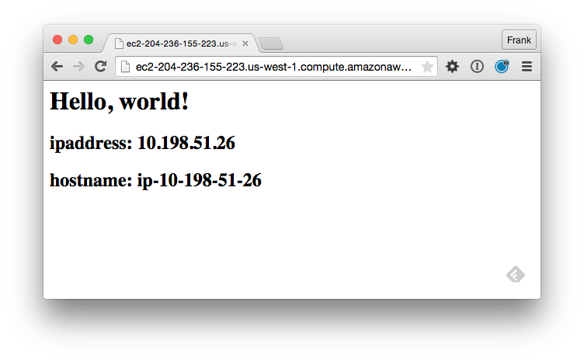

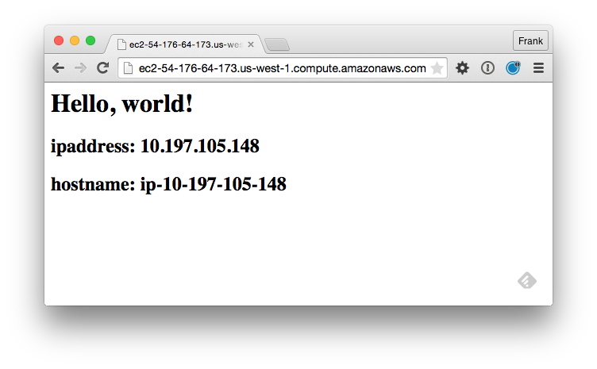
Notes:
Point a web browser to the URL or public IP address of your proxy server. It should display the web page of the web server node that the proxy server is configured to serve.
Nothing should change externally. You may see some differences in the logs as the proxy configuration file might change the order of the two entries but the end results is that our proxy server node is still delivering traffic to our two web server nodes.

Slide 36
Discussion
Attributes are like parameters to your cookbook – no hard-coded values in recipes or templates
Can you imagine in complex topologies, where you could have multiple levels of dependencies between cookbooks – berkself handles all of that out the box
Notes:
Answer these questions.
With your answers, turn to another person and alternate asking each other asking these questions and sharing your answers.

Slide 37
Q&A
What questions can we help you answer?

